Slide 1
A Small Exercise
Suppose you need to implement a movie rental system
Your movie rental system must deal with
Three kind of movie rental
New release ($3)
Regular ($2)
Children ($2)
A movie, of course, can have several copies
A customer can ask for a statement
Please write down
the draft classes, some primary methods in each class
A main() to show how your classes are used.
‹#›
Notes:
‹#›

Slide 2
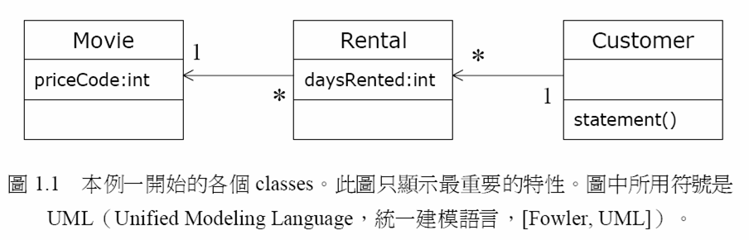
an example
The movie rental system
Please take time to read movie-p05.java
write down your thoughts
Why is it bad from your experience?
How you plan to change it? (Compare it with your version, which is better?)
‹#›
Notes:
‹#›

Slide 3
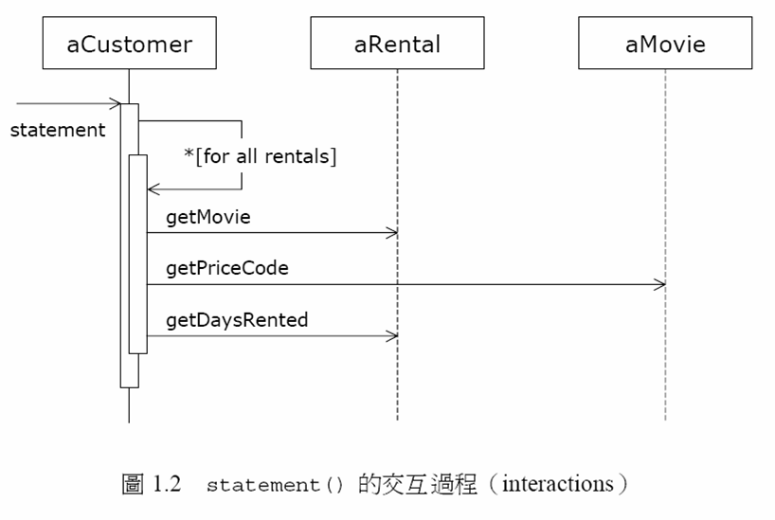
‹#›
Notes:
‹#›

Slide 4
movie-p05 的問題
not well designed, poorly written
hard to change to deal with obvious future evolution.
A design is made to deal with focused future change
還記得我曾經告訴你們，沒有任何一個 design 是正確答案。
當你要判定一個 design 是否設計良善，你得先看看他所要對付的未來維護需求是什麼
‹#›
Notes:
‹#›

Slide 5
未來的維護需求
幾乎一定會發生
可能會發生
會發生但是可能性微乎其微
‹#›

Slide 6
所以?
這個例子的幾個主要未來維護需求是什麼?
片子的種類會新增與刪減 (一定會發生)
片子的常客基點與常客的促銷邏輯會更改 (應該會發生)
片子的 print_statement 印出的格式會不斷地修改
片子的價格會改變
一個片子會從新片變成舊片
‹#›

Slide 7
Image a future change – customer wants a new function called htmlStatement()
You will find you cannot reuse any code in p05 formally.
Eventually, you copy-paste statement() and modify it into a new htmlStatement()
Some time in the future, you need to change the rule of computing frequent renter points
You need to change two places and maintain the consistency at two places.
‹#›

Slide 8
As time goes by
As time goes by, programmers come and go and movie-p05 becomes chaotic
Every fix can be done at once. There are too many places to fix anytime a change request is made by customer because more and more places should remain consistent
When cost(fixing＋debug+testing) > cost(rework) it is time to rebuild
It is called software entropy(熵)
changes to a bad code is hard
‹#›
Notes:
‹#›

Slide 9
Let movie–p05 can deal with Change (The first step)
Change movie-p05 113-130 into a method of customer
Each -> aRental
Logic：centralize the part of code that is subject to change in the future
Result is in movie-p11.java
‹#›
Notes:
‹#›

Slide 10
Review movie-p11 again
Do you have any unpleasant feeling about the amountFor() in Customer?
amountFor uses two many information from other classes.
In most cases, a method should be on the object whose data it uses.
We move amountFor() to Rental class to become a method getCharge()
remove temp variable thisAmount
see movie-p21.java
‹#›
Notes:
‹#›

Slide 11
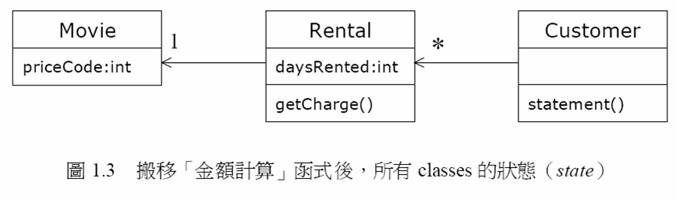
p19
‹#›
Notes:
‹#›

Slide 12
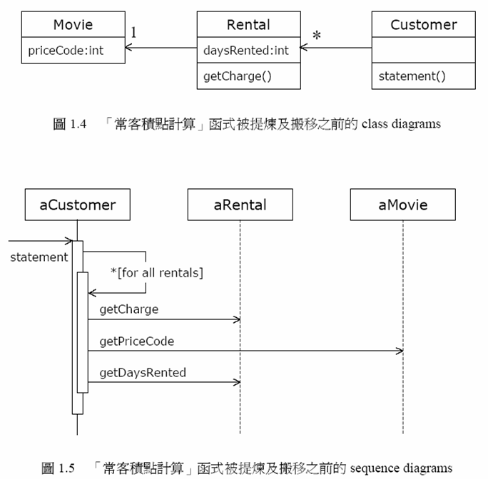
p24
‹#›
Notes:
‹#›

Slide 13
Movie-p21.java
Now，in movie-p21.java, statement() becomes much better
Besides, 101-106 include another part of code that is subject to change
We change it into another method of Rental class getFrequentRenterPoints()
see movie-p25.java
‹#›
Notes:
‹#›

Slide 14
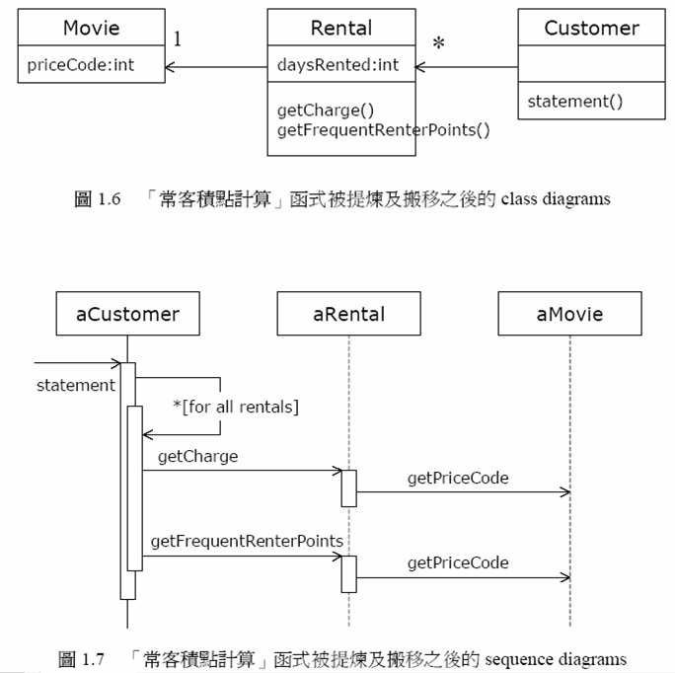
movie-P25.java
‹#›
Notes:
‹#›

Slide 15
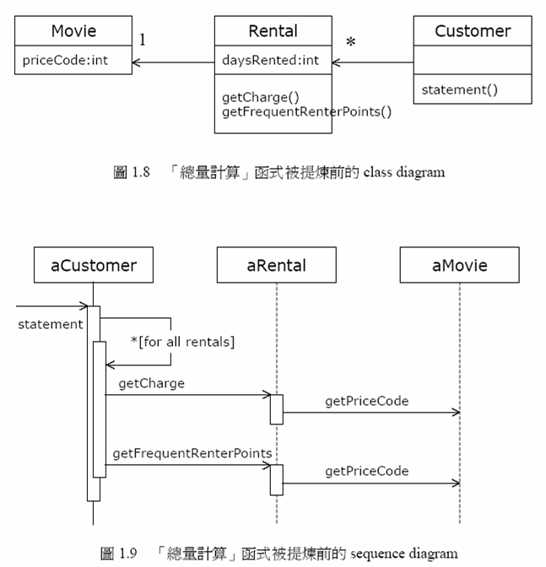
p30
‹#›
Notes:
‹#›

Slide 16
Remove temp variables
temp variables can be a problem, which encourage long routines
remove temps totalAmounts and frequentRenterPoints
see movie-p33.java
In movie-p33.java a htmlStatement() method is added. -> now if we want to change rule, only one place should be changed.
‹#›
Notes:
‹#›

Slide 17
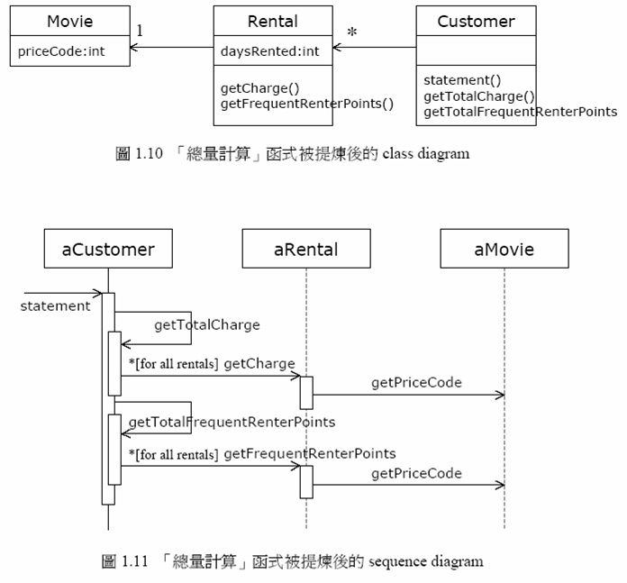
movie-p33
‹#›
Notes:
‹#›

Slide 18
Review movie-p33.java
Is this code perfect now? not yet
It is a bad idea to do a switch based on an attribute of another object
For example, when a new movie class called Adult is added, changes are
Change the definition in movie class.
Rental::getCharge() should be changed
Let’s move getCharge(), getFrequentRenterPoints() 的 code 搬到 movie class
see movie-p37.java
‹#›
Notes:
‹#›

Slide 19
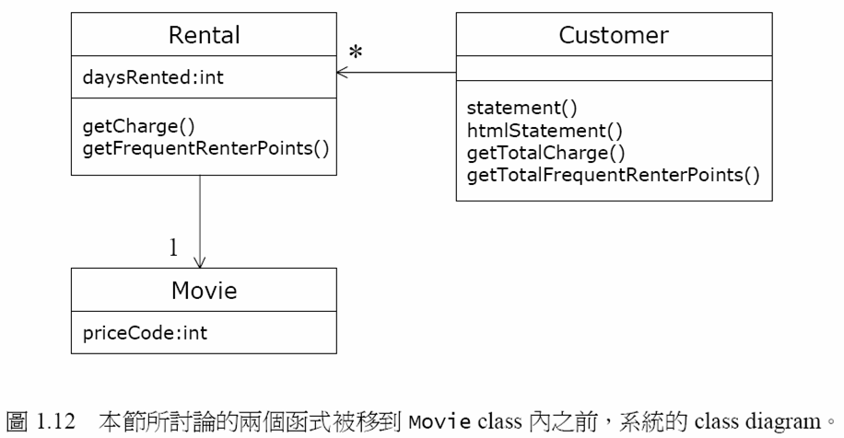
p36
‹#›
Notes:
‹#›

Slide 20
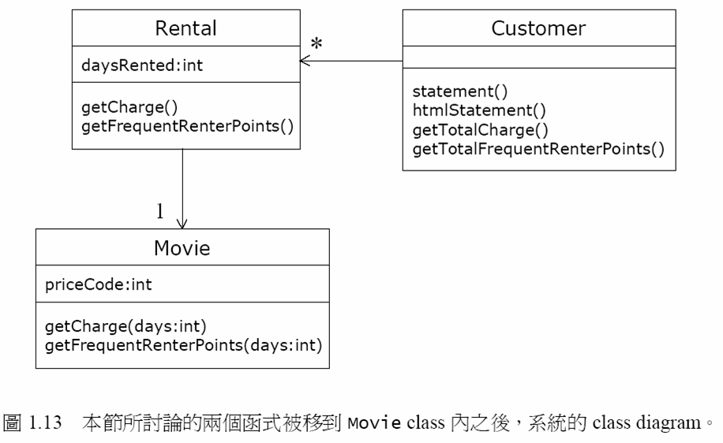
p37
‹#›
Notes:
‹#›

Slide 21
Review of movie-p37
So, how about it now? perfect? not yet
switch in getCharge() is a typical bad code which cannot answer changes well.
In practice, such switch() can occurs in several places (recall that when polymorphism is introduced). Each switch must be kept consistent。
Often, a switch that will change from time to time satisfies the precondition of subclassing. We can replace it by polymorphism and inheritance
‹#›
Notes:
‹#›

Slide 22
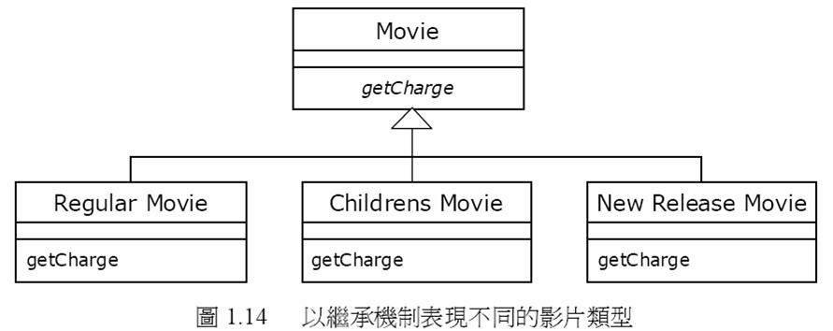
Move each branch of switch to subclasses getCharge 中
We replace switch statement with polymorphism
Feeling good? (自我感覺良好嗎?)
‹#›
Notes:
‹#›

Slide 23
Unfortunately，such inheritance structure has flaw. However, amateur OO analysts will most reach such kind of results
In this application, a movie object may change its classification during life time
E.g., suppose a new release film Q changes to a regular movie
Consequently, what will you do?
New a regular movie P
Clone the data of Q to P
Destroy Q
That’s it? (No. take a look at the main())
An object cannot change its class during life time
‹#›
Notes:
‹#›

Slide 24
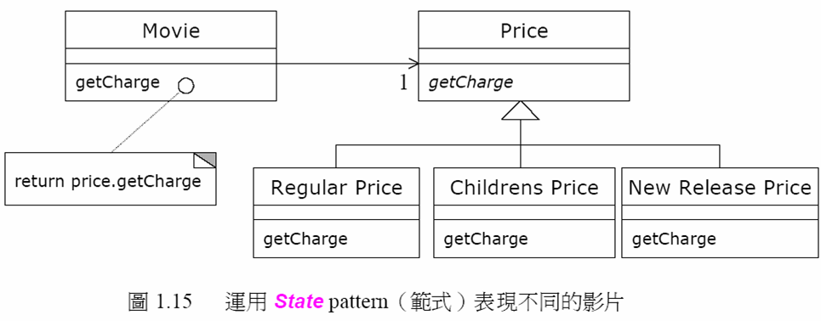
state design pattern
‹#›
Notes:
‹#›

Slide 25
The correct answer is change movie-p37 to movie-p52.java using state design pattern
Please see movie-p52.java
‹#›
Notes:
‹#›

Slide 26
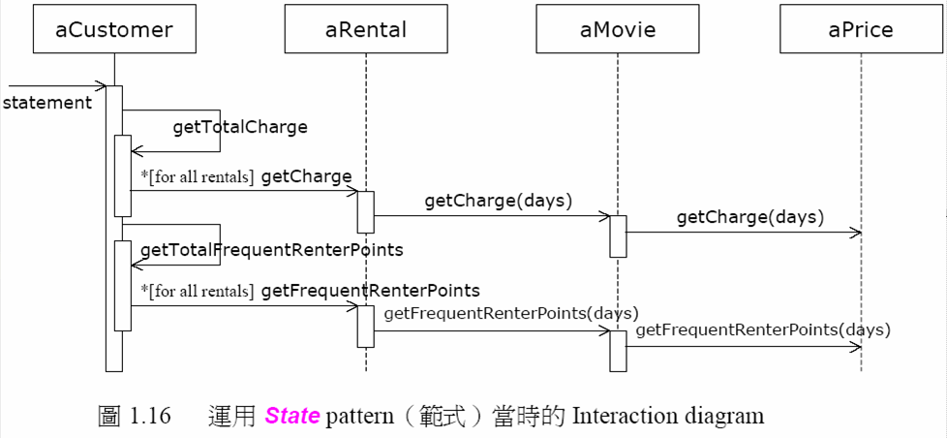
p51 Fig1.16
‹#›
Notes:
‹#›

Slide 27
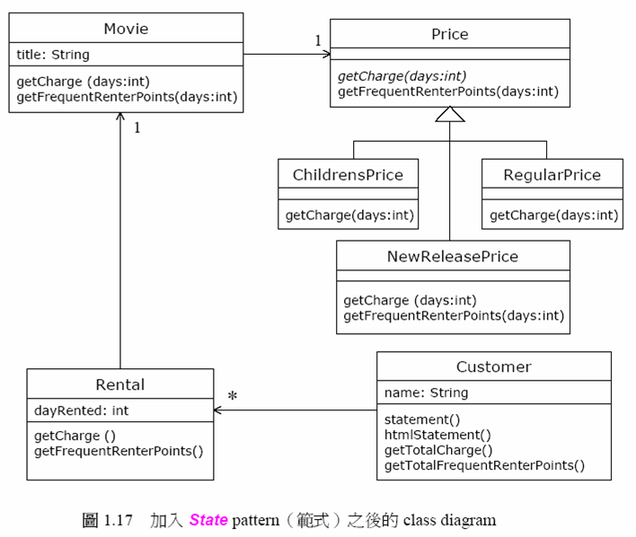
p51 F1.17
‹#›
Notes:
‹#›

Slide 28
Refactoring (重構）
The above technique is called refactoring, a mechanism to improve architecture of as-build codes.
change is based on step by step and each step is validated by all the testing cases.
It is of course, not cost-free
‹#›
Notes:
‹#›

Slide 29
Design Patterns
過去，在實做各種各類的軟體過程中，許多人累積了寶貴的物件導向分析經驗。經過蒐集整理，這些寶貴的繼承架構，class diagram，物件互動架構等等，被蒐集成所謂的 design patterns。
When you encounter some problems in OOAD or OOP. It is rare that your problem is new.
Some people collects these problems and solution into a some form of reuses.
design patterns are one kind of reuse, but not code reuse. Instead, it is a kind of pattern reuse.
‹#›
Notes:
‹#›

Slide 30
Discussion
The main purpose of OOAD is to make our code easy to maintain, change, and evolve,
Good analysis is difficult
Don’t expect you will become a OOAD expert because you take the course.
Typically, having analysis is better than no analysis. Recall the integrity of architecture and thought.
‹#›
Notes:
‹#›

Slide 31
Discussion
Good architecture != good performance
In most cases, good architecture may have worse performance.
In some design concerns, some classes will be merged to increase performance (if they are found to be guilty of the blame)
Programmers that can write good and clean OO code are hard to find.
Good analysis, of course, can be used to create good teamwork (WBS work breaking structure)
Good analyst can smell the change in system design and make the part OO ly
Don’t overdesign. If the change will not occurs within 100 years, make the part Ooly is a waste of time.
Good OOAD must eventually demonstrate at the level of code. Extensive programming experience is required.
‹#›
Notes:
‹#›

Slide 32
Discussion
In a software development project. How much efforts should be put in OOAD?
What type of software you build (what kind of market you are in)?
e.g. there is no need for analysis for most research
Is evolveability very important in your area?
is technology changing very fast in your area?
How long is your design/code typically out of date and thrown away?
what is the scale of your software?
what is the total cost of your software?
Are documentation/process important in your company?
Have your programmers high transition rate?
How much quality you care?
6 month design/planning, 3 month coding, 3 month testing
‹#›
Notes:
‹#›

Slide 33
Thanks
Q & A
‹#›
Notes:
‹#›

